Slide 1
WORK AT ALL COSTS: WOMEN
Psychologist Odeta Šakėnaitė
2023

Slide 2
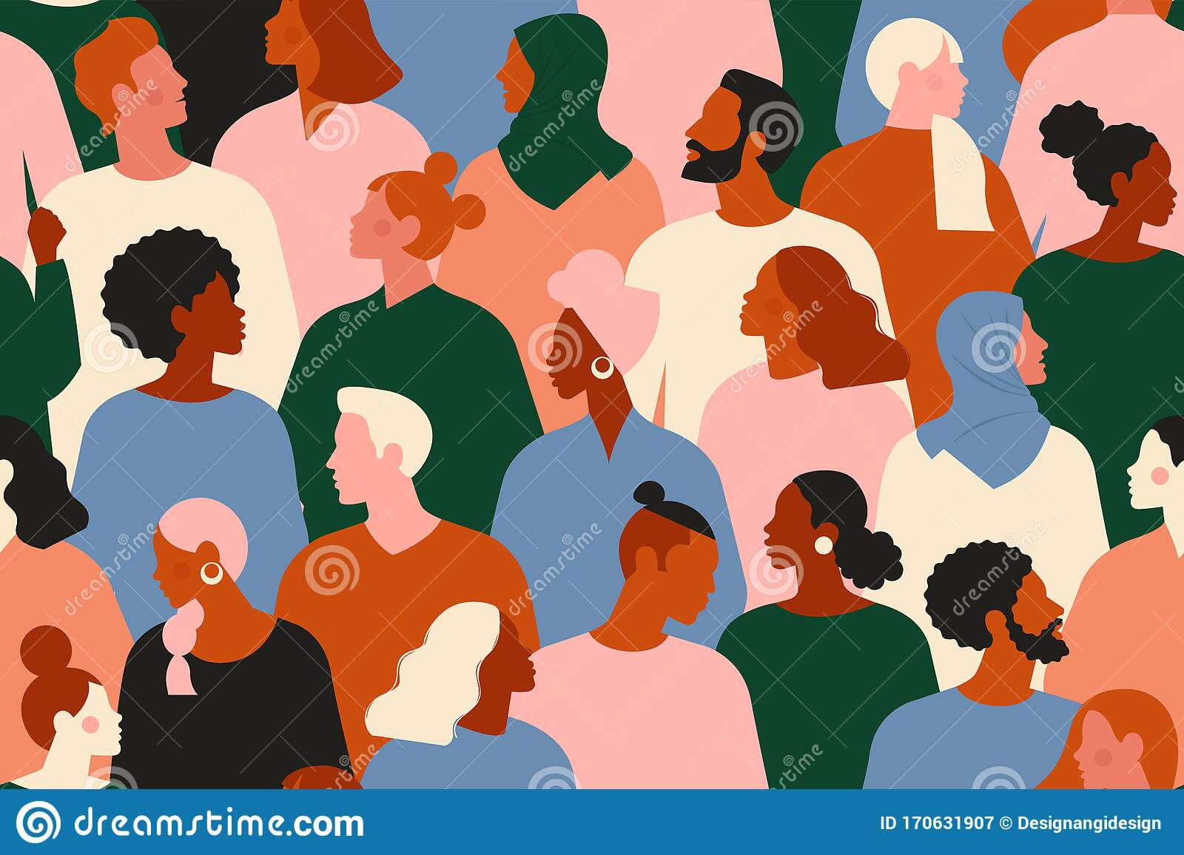
GENDER DIFFERENCES: STATISTICS
We should have in mind that of 7.8 billion inhabitants on Earth, women are the majority.
Women takes 47.7% of the global workforce. But around 48% of women occupy entry-level roles.
42% of women claim they have been discriminated at work because of their gender.
According to 61% of women, having children reduces their chances for advancement.
Almost 70% of women prefer having a paid job rather than staying at home [8]

Slide 3
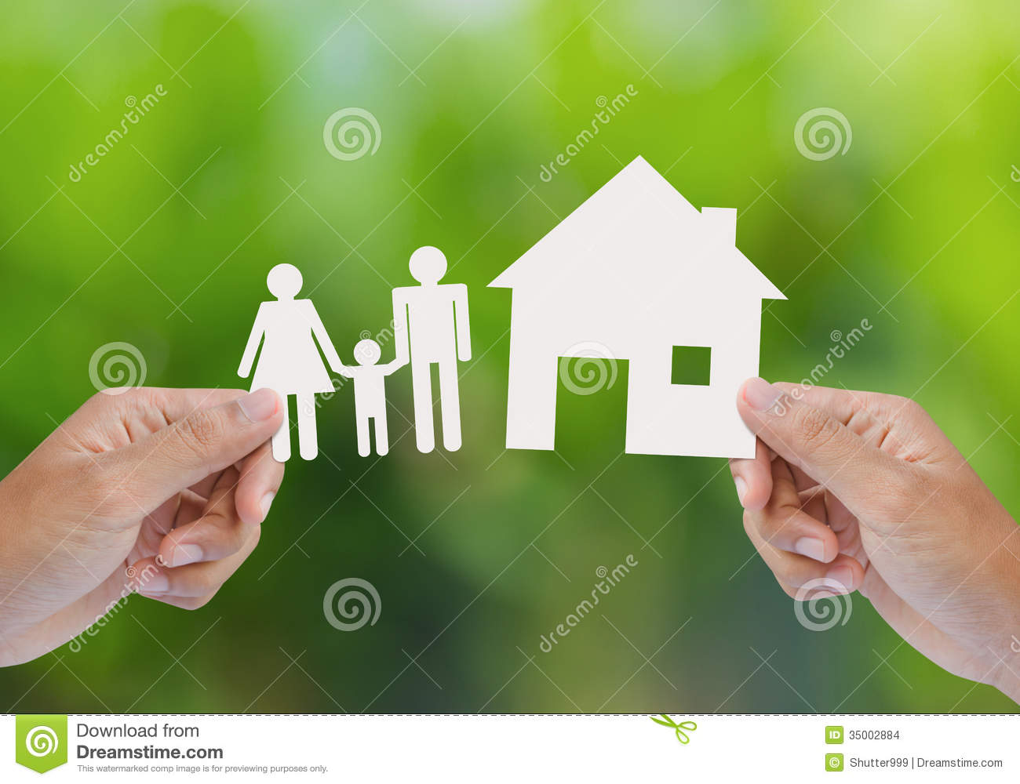
GENDER DIFFERENCES: STATISTICS
Still, for the past 27 years, the gender employment gap has only decreased by 2 percentage points.
Studies show that women spend 4 hours and 25 minutes a day doing unpaid care work while men spend 1 hour and 23 minutes.
Women's daily caregiving time decreased by only 15 minutes between 1997 and 2012, while it grew by 8 minutes for men.
It is predicted that if things continue this way, the gender disparity in unpaid care will be eliminated in 209 years (or after 7-8 generations) [8]

Slide 4
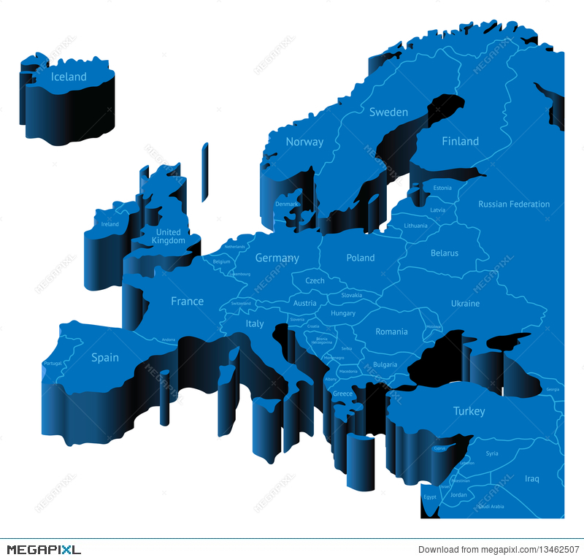
GENDER DIFFERENCES: EUROPE
Even though the concept of equal pay has been incorporated in the European Treaties (article 157 TFEU) since 1957, there are some instances where women are paid less than men for performing equivalent work or work of equal value.
Women in the Europe made, on average, 12.7% less per hour than men in 2021.
But we must keep in mind that the EU member states differ greatly from one another [7]
But why do women earn less?

Slide 5
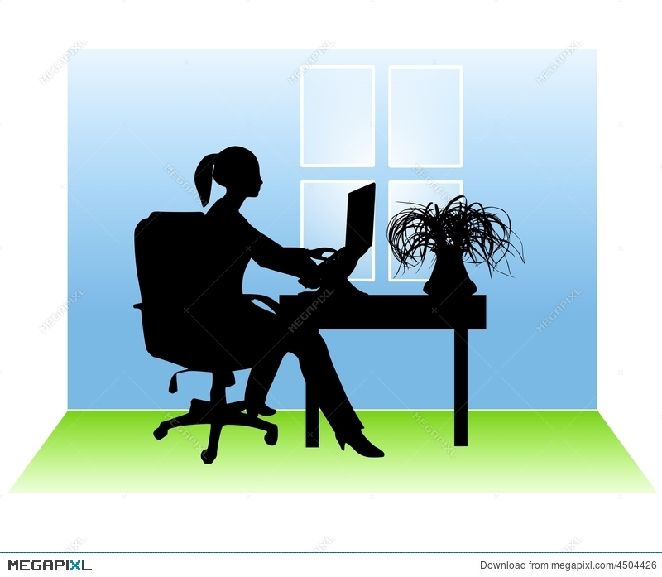
GENDER DIFFERENCES: EUROPE
Beyond pay disparity, the gender pay gap measures a broader concept:
Work sector differences: Women who work in fields that pay less than average, like caregiving, health, and education sectors, account for about 24% of the gender pay gap. Highly feminized jobs frequently suffer from systemic undervaluation.
Pay and unpaid work distinctions: Including unpaid labor hours, women often work more hours per week than males. This is why European Union supports organizations with flexible work schedules, adequate public daycare supply, and equal parental leave distribution.
The majority of the gender pay gap is believed to not be related to worker or workplace factors like education, occupation, working hours, or the type of economic activity an individual works for [7]

Slide 6
GENDER DIFFERENCES: WAYS TO DISCRIMINATE
What other ways to discriminate?
Statistical discrimination - beliefs about gender differences in abilities or skills (such as men are better at numbers, strategies).
Taste-based discrimination - stereotypes, favoritism for one group, and a bias against another group.
“With statistical discrimination, you have certain beliefs about men versus women and what they can do, and given those beliefs, you choose the person who you think is the best person to hire. You are simply acting in a way that you think will maximize your profits” [3]

Slide 7
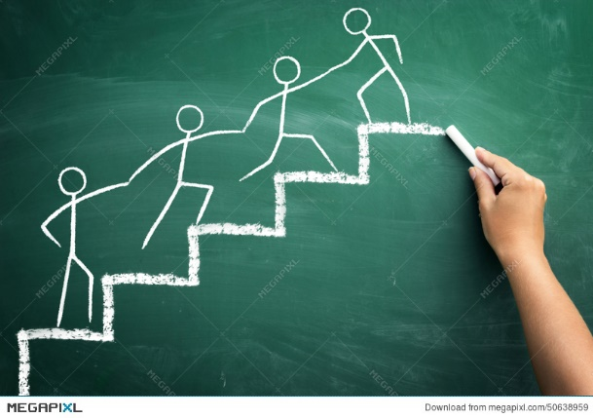
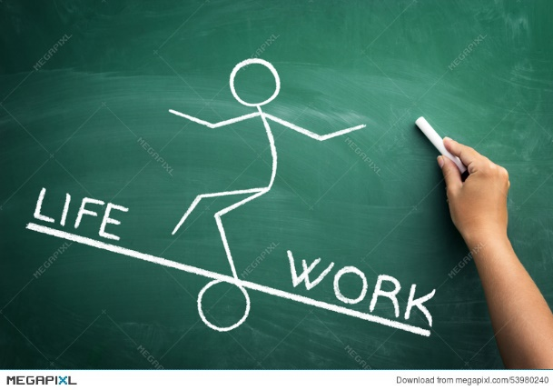
GENDER ROLES: REDEFINING WORK
In order to recognize all the work women do, paid and unpaid, we must redefine what "work" means in order to achieve equally paid work.
Caregiving for children or elderly relatives is an example of unpaid care work. Likewise all housework. And as we well know, women perform the majority of this type of job—the unpaid care work.
Women and girls are responsible for 75% of all domestic chores. Finding a balance between work and family responsibilities is extremely difficult for working women as a result of the unequal distribution of the workforce between men and women. Societies and economies frequently disregard the "invisible" labor performed by women. As something that simply comes with being a woman, and is taken for granted [9, 10]

Slide 8
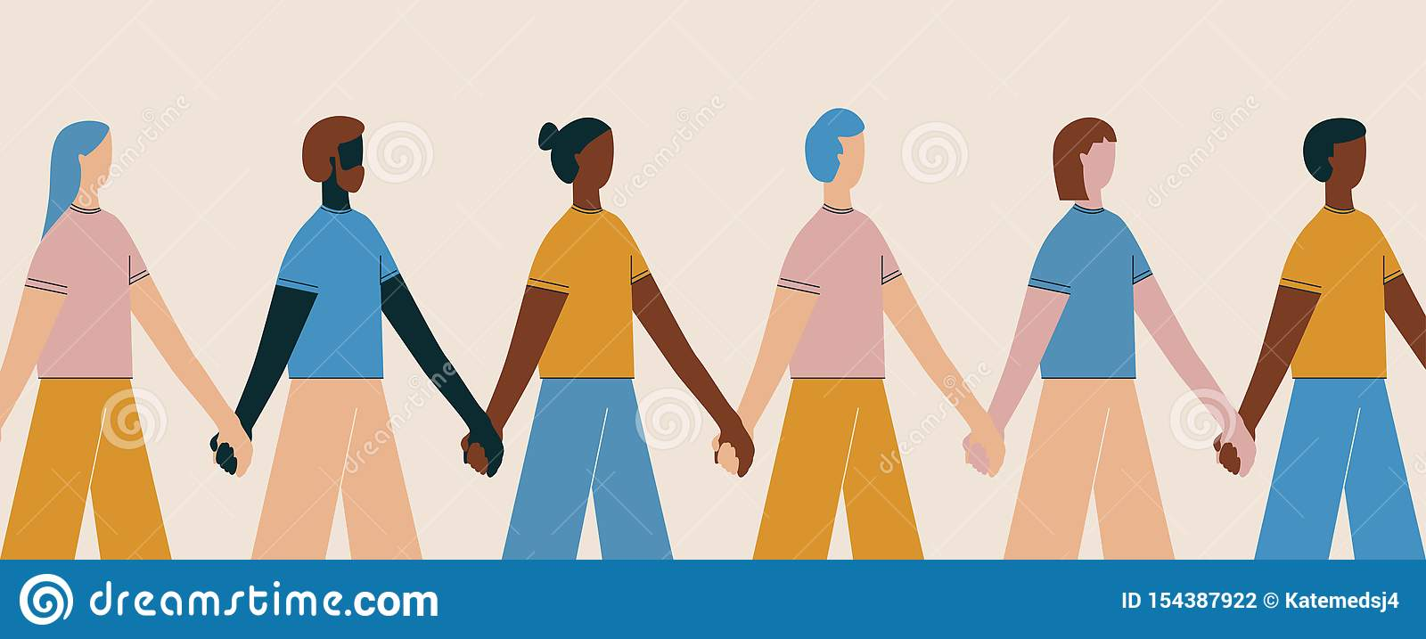
GENDER ROLES: REDIFINING WORK
There is a theory that the third largest sector would be the unpaid care work performed by women if it were adequately funded. Compared to manufacturing, trade, and transportation, this sector would contribute more. Many women who must do unpaid caregiving duties rather than finding employment, however, have little time to challenge the system that is driving them into poverty [8]

Slide 9
WORK – FAMILY BALANCE: WORKING MOTHERS
Due to a childcare system that is completely insufficient for a culture where the majority of parents work outside the home, working mothers were already responsible for the majority of family caregiving duties. Women are more likely to stay in the workforce or quit if access to childcare becomes more problematic;
The childcare system also relies on an underpaid, largely female workforce, making it problematic for both the people it employs and the people it serves.
Working mothers were found to be 40% more stressed than the ordinary individual, according to a recent UK study (2019). According to research, moms must split their time with their children and dependents because they are accustomed to receiving assistance and care for them.
Mothers' time spent with their children has remained stable despite the recent large increases in female labor force participation. Instead, the amount of time spent by women on leisure and home tasks decreased [9,10]

Slide 10
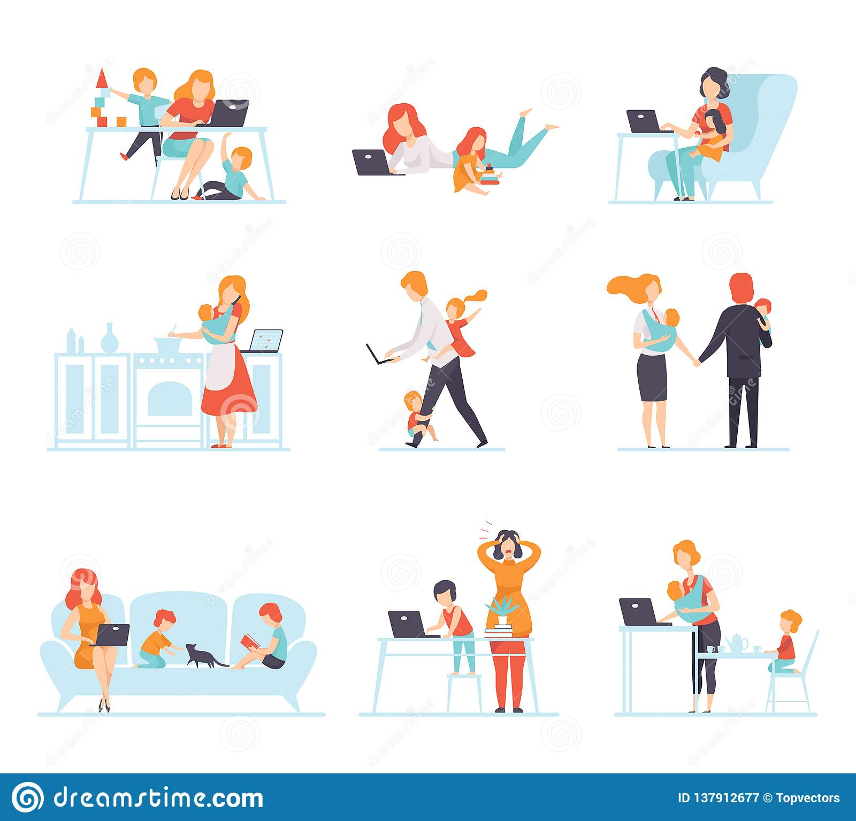
DOUBLE BURDEN: WORKING MOTHERS
The difficulties a mother encounters while juggling work and home duties (such as caring for children and doing household tasks) are frequently described as a "double burden„
Numerous studies have been done on the "second shift," or how working mothers balance their duties to their families and their careers.
Throughout life, "double burden" takes on different forms. As a woman matures from a young adult to an older adult, for instance, her role in the family changes. When the kids become older, her childcare responsibilities may decrease, but when she becomes a grandmother, they might rise [9]

Slide 11
WORK – FAMILY BALANCE: COVID-19
The pandemic has particularly highlighted how crucial unpaid domestic and care work is on par with paid job. Despite the fact that the epidemic brought about a severe and obvious catastrophe, the lack of assistance for families and workers was already a problem.
The extent and volume of domestic work, as well as children missing school, increasing responsibilities for caring for dependents, and intensive cleaning and health services, have all expanded dramatically as a result of the global spread of COVID19 (2020). Additionally, many working women did not have access to childcare or other support services during the lockdown, adding to the pressure on women and restricting their capacity to work. During the pandemic, one out of every four women who lost their jobs said it was because of a lack of childcare, which is twice the rate of men asked.
Before COVID-19, about half of all working women held occupations with poor compensation, with a median hourly wage of just $10.93. This demonstrates the fact that many women rely on low-paying employment to provide for their family and themselves.
Women are underpaid in comparison to men even when they make the "right" decisions, such as finishing their education and seeking jobs in high-paying industries and professions [6]

Slide 12
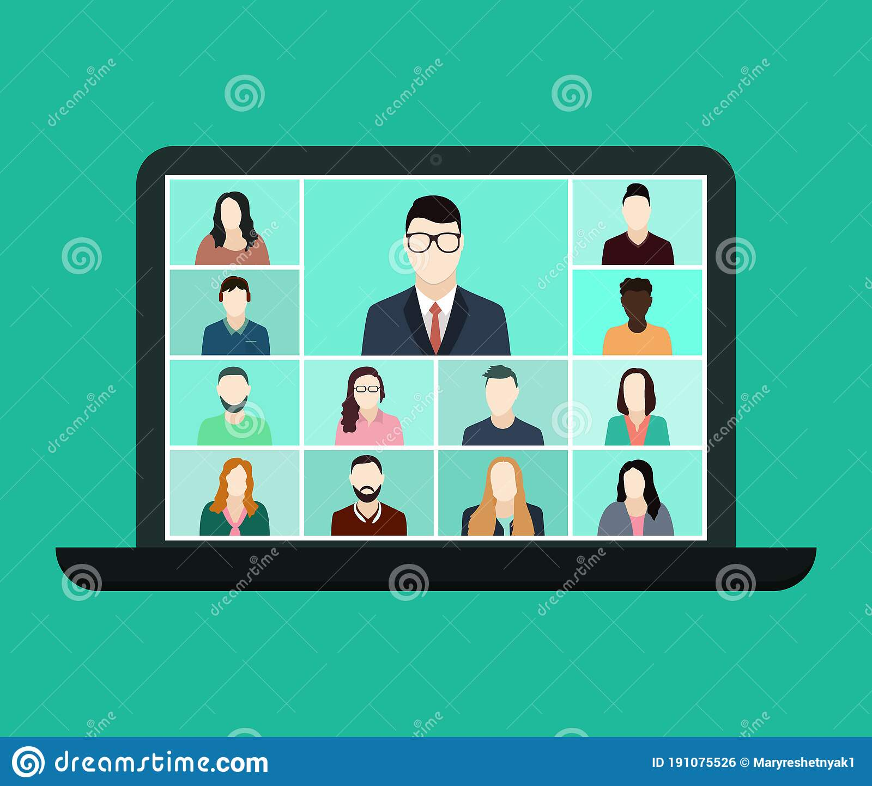
REMOTE WORK
Women value the ability to work remotely in particular. Only 1 in 10 women wants to work on-site all the time.
Working from home makes women less stressed, happier in their careers, and significantly less inclined to consider leaving their employers. Women report less microaggression and greater psychological safety when they work remotely at least occasionally.
Studies have also shown that women with disabilities benefit most from remote and hybrid work because they can more easily manage mobility challenges, chronic pain, and mental health conditions when they have greater control over their working environment.
However, there is a potential problem in the future: without defined boundaries, flexible employment might easily become 24/7 work. These types of employees are considerably more prone to feel burned out and think about leaving their employers [11, 12]

Slide 13
WOMEN LEADERS ALSO STRUGGLE
Since 2016, we have observed the same pattern: women being promoted to manager positions at significantly lower rates than men, which makes it difficult for businesses to establish a foundation for long-term advancement at more senior levels.
64% of women experience microaggressions at work, including having their opinions and ideas discounted and their judgment and expertise called into question or being mistaken for someone more junior, is more likely the cause of women leaders leaving their companies. They are much more likely than males in leadership, for instance, to have colleagues insinuate that they aren't fit for their positions.
According to studies on workplace sexism, 71% of women believe that their superiors' "unconscious bias" is keeping them from advancing to leadership roles. In addition, 77% of moms claim to have encountered discrimination at work while expecting a child [11,12]

Slide 14
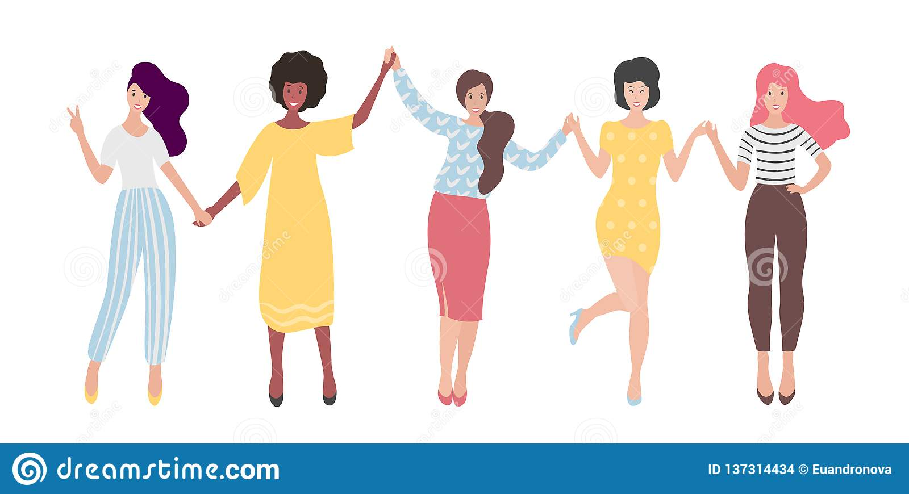
EMPOWERING WOMEN
The wellbeing and socioeconomic advancement of families, communities, and nations depend on the empowerment of women. We should see a change in society's perception of and discourse on labor, one that acknowledges the effort and the worth of all work.
Women can be empowered through supporting their sense of self-worth, their freedom to make their own decisions, and their right to have an impact on social change for both themselves and other people [4]

Slide 15
CONCLUSIONS
We are still in a process of a change, in a process of having a better world for women. And in order to reach this goal:
1. We must end all forms of discrimination against women and girls everywhere.
2. Recognize and value the unpaid care and domestic work through the provision of public services, infrastructure and social protection policies and the promotion of shared responsibility within the household.
3. Ensure women’s full and effective participation and equal opportunities for leadership at all levels of decision making in political, economic and public life.
4. Treat all people fairly at work, respecting and supporting non-discrimination and human rights.
5. Measure and report publicly on progress to create gender equality [5]

Slide 16
REFERENCES
https://teamstage.io/women-in-the-workforce statistics/#:~:text=Women%20account%20for%2047.7%25%20of,employed%20women%20love%20their%20job
https://www.un.org/sustainabledevelopment/gender-equality/
https://hbswk.hbs.edu/item/why-employers-favor-men
https://www.worldvision.com.au/womens-empowerment/
https://www.un.org/sustainabledevelopment/gender-equality/
https://www.brookings.edu/essay/why-has-covid-19-been-especially-harmful-for-working-women/
https://commission.europa.eu/strategy-and-policy/policies/justice-and-fundamental-rights/gender-equality/equal-pay/gender-pay-gap-situation-eu_en
https://www.oxfam.org.uk/about-us/how-oxfam-changing/how-to-make-valuing-all-womens-work-a-reality/
https://www.ncbi.nlm.nih.gov/pmc/articles/PMC6587579/
https://www.ncbi.nlm.nih.gov/pmc/articles/PMC8251227/
https://www.mckinsey.com/featured-insights/diversity-and-inclusion/women-in-the-workplace
https://www.tuc.org.uk/news/gender-pay-gap-means-women-work-free-nearly-two-months-year

